Slide 1
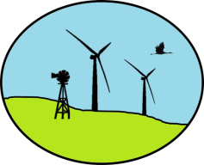


Wind Energy Development & Wildlife in Nebraska
Caroline Jezierski
Nebraska Wind Energy & Wildlife
Project Coordinator
http://snr.unl.edu/renewableenergy/wind/
Updated October 4, 2013

Slide 2
Instructions for Teachers - 1
The goal of this activity is to introduce students to the basics of wind energy, siting, and wildlife considerations.
This activity was initially designed as a guest lecture in college level courses.
It has also been used successfully with an 8th grade class.

Slide 3
Instructions for Teachers - 2
All maps are available for download @: http://snr.unl.edu/renewableenergy/wind/moreinformation.asp
If you would like to have me available for questions on the day you do this activity in your class, please coordinate with me beforehand. I can be reached at windwildlife@unl.edu.

Slide 4
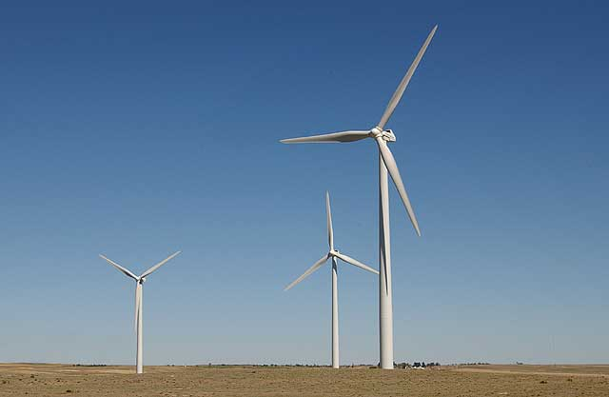
How is Wind Energy Produced?
How is Wind Energy Produced?
The blades of wind turbines turn in the wind and power an electric generator.
The energy of the wind is converted into mechanical power or electricity.
Electricity is brought to cities and homes via transmission lines.
Notes:
The turning of the turbine blades produces electricity.
When thinking about wind energy – you need wind turbines AND transmission lines to bring that wind energy to communities or where ever it is going to be used.

Slide 5
Wind Turbines
Modern turbines are HUGE compared to old-school windmills
Total Height: 97 – 150 m (318 – 492 ft)
http://www.aweo.org/windmodels.html

Slide 6
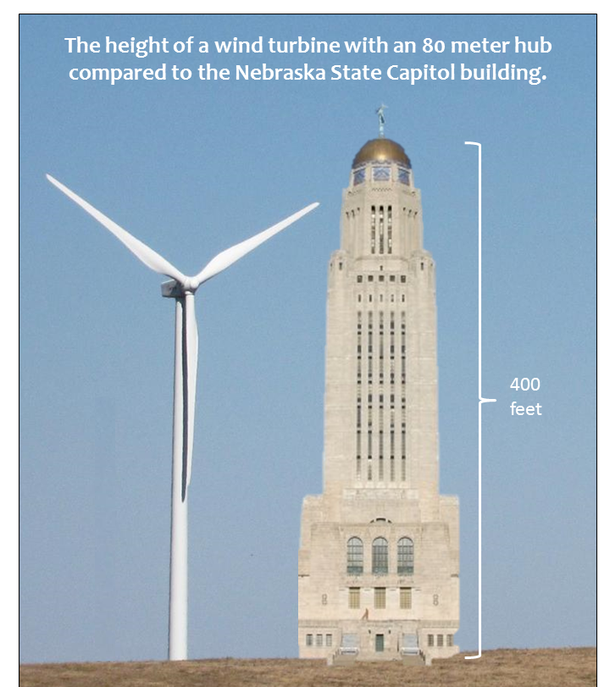
Notes:
I pasted the Nebraska capitol building next to a wind turbine to show the height of the turbine.

Slide 7
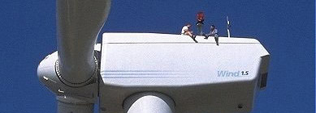
Wind Turbines
http://www.aweo.org/problemwithwind.html
Notes:
People sitting on the nacelle (“little boat”), where the generator for the turbine is located.

Slide 8
Wind Turbines
Modern turbines are HUGE compared to old-school windmills
Total Height: 97 – 150 m (318 – 492 ft)
Blade Length: 31 – 56 m (102 – 184 ft)
http://www.aweo.org/windmodels.html

Slide 9
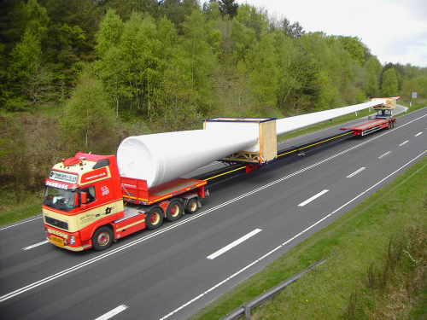
www.renewableenergyfocus.com

Slide 10
Wind Turbines
Modern turbines are HUGE compared to old-school windmills
Total Height: 97 – 150 m (318 – 492 ft)
Blade Length: 31 – 56 m (102 – 184 ft)
Area Swept by Blades: 3, 019 – 9,852 m² (0.75 – 2.43 acres)
http://www.aweo.org/windmodels.html

Slide 11
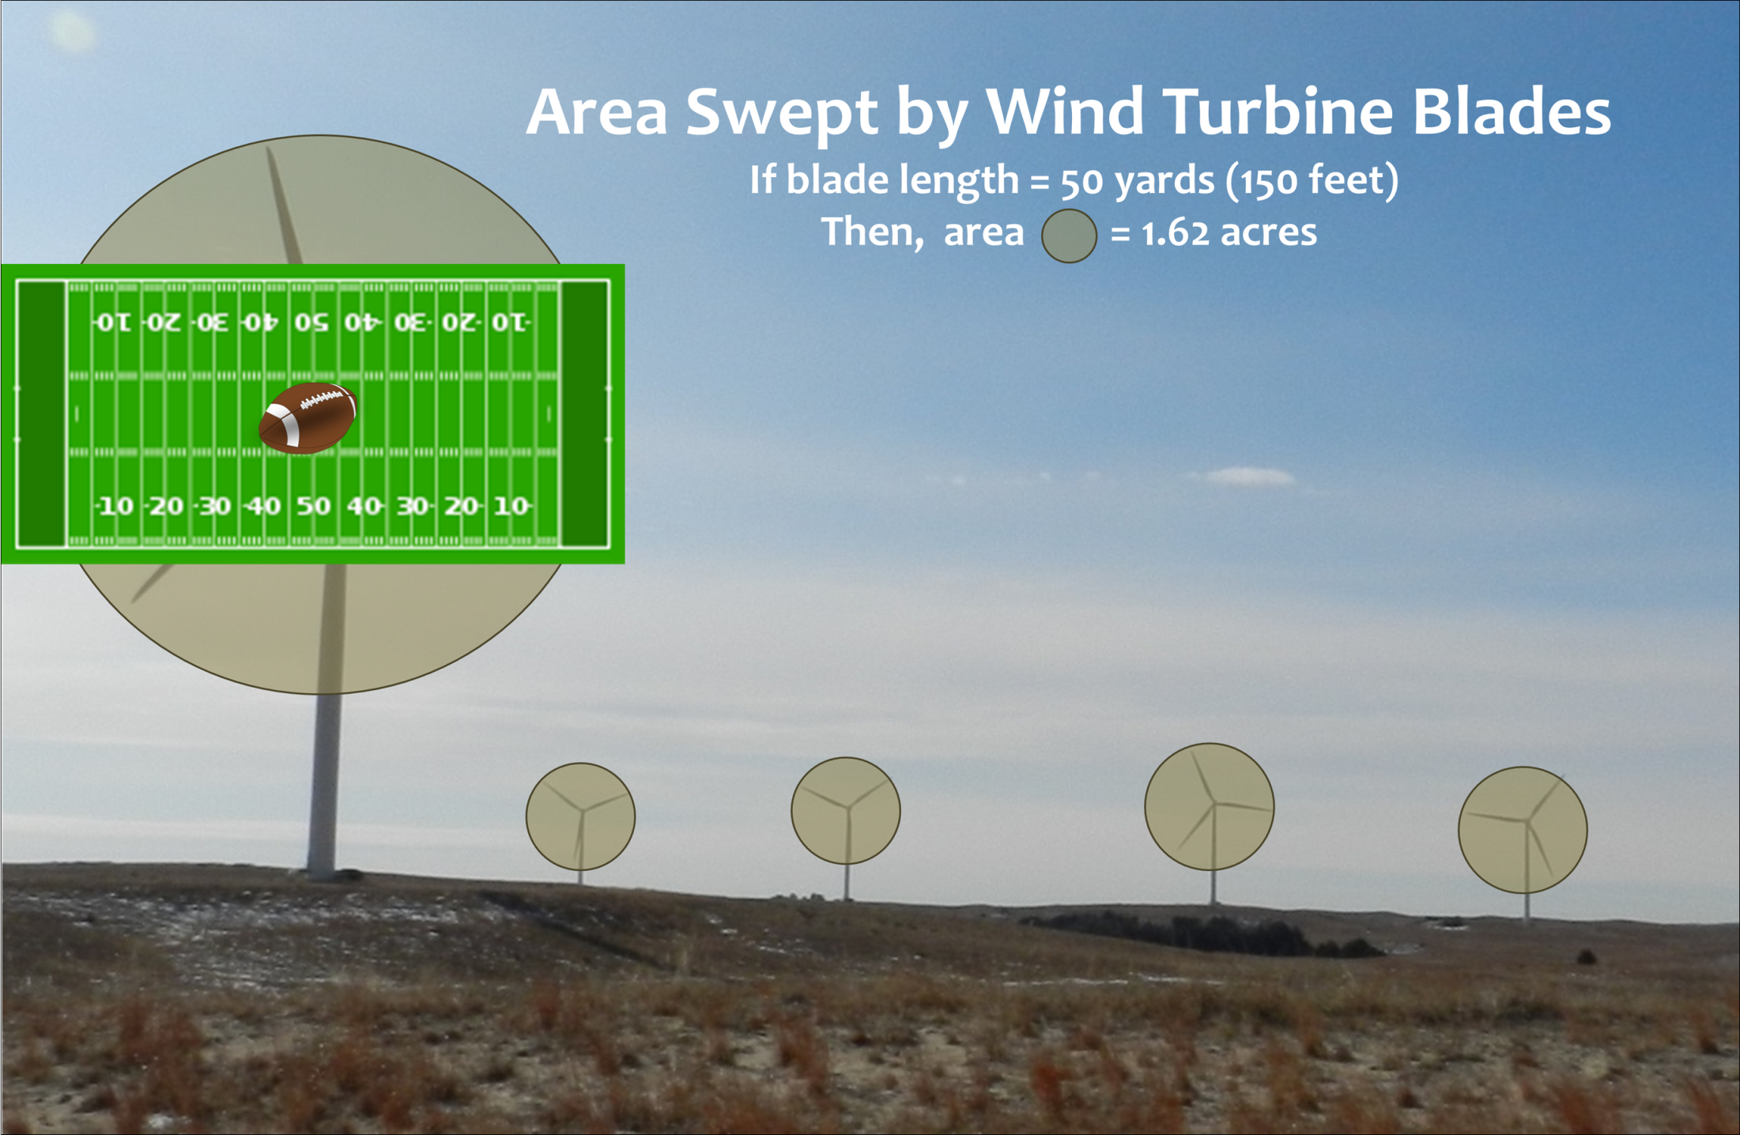
Notes:
Most turbine blades are measured in meters, but for illustration purposes, I used yards. Fifty yards is well within the length range of turbine blades used for terrestrial wind energy developments.
Longer blades are being developed especially for off-shore development. A 100 yard blade has an area swept of almost 8 acres.

Slide 12
Wind Turbines
Modern turbines are HUGE compared to old-school windmills
Total Height: 97 – 150 m (318 – 492 ft)
Blade Length: 31 – 56 m (102 – 184 ft)
Area Swept by Blades: 3, 019 – 9,852 m² (0.75 – 2.43 acres)
Max Blade Tip Speed: 138 – 232 mph
http://www.aweo.org/windmodels.html
Notes:
Although wind turbine blades may appear to be going slow, they can actually move quite fast. Due to physics, the tip moves the fastest.

Slide 13
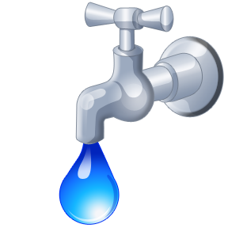


Why Wind Energy?
Renewable energy
CO₂
Rural Communities
Energy security
Notes:
Does not use water to produce energy.
Does not emit carbon dioxide during energy production.
Provides money to rural communities.
Provided more energy security than using foreign fossil fuel energy sources.

Slide 14
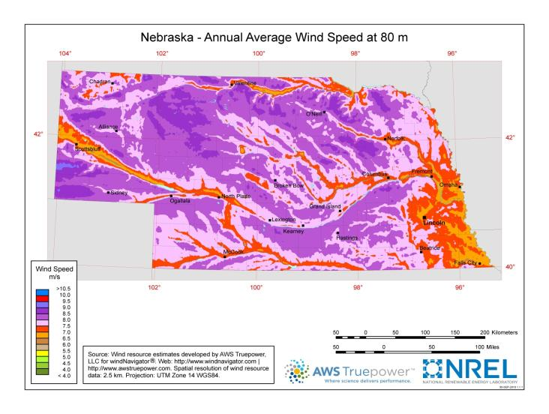
Nebraska Wind Energy Potential (80m)
Wind speeds 6.5 m/s or above are suitable for large-scale wind energy development
Most areas in Nebraska have suitable wind speeds for development.
http://www.windpoweringamerica.gov/images/windmaps/ne_80m.jpg
Notes:
80 meters is the hub height of most large-scale wind turbines used for terrestrial wind energy developments right now.

Slide 15
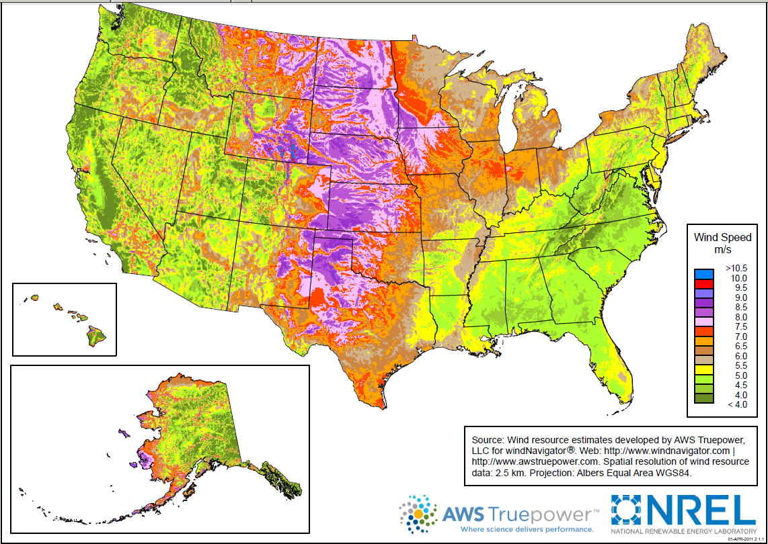
Wind Energy Potential @ 80m
NE is ranked 4th in the U.S. for potential wind power generation.
http://www.windpoweringamerica.gov/wind_maps.asp
Notes:
Great swath of wind energy potential through the middle of the U.S.

Slide 16
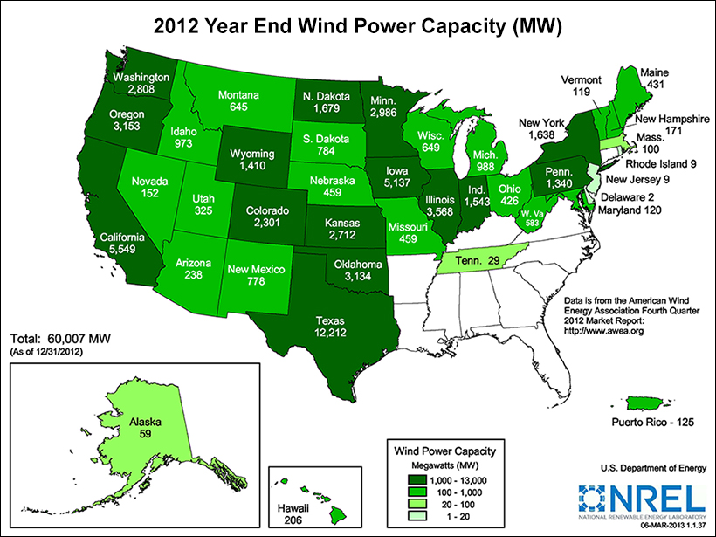
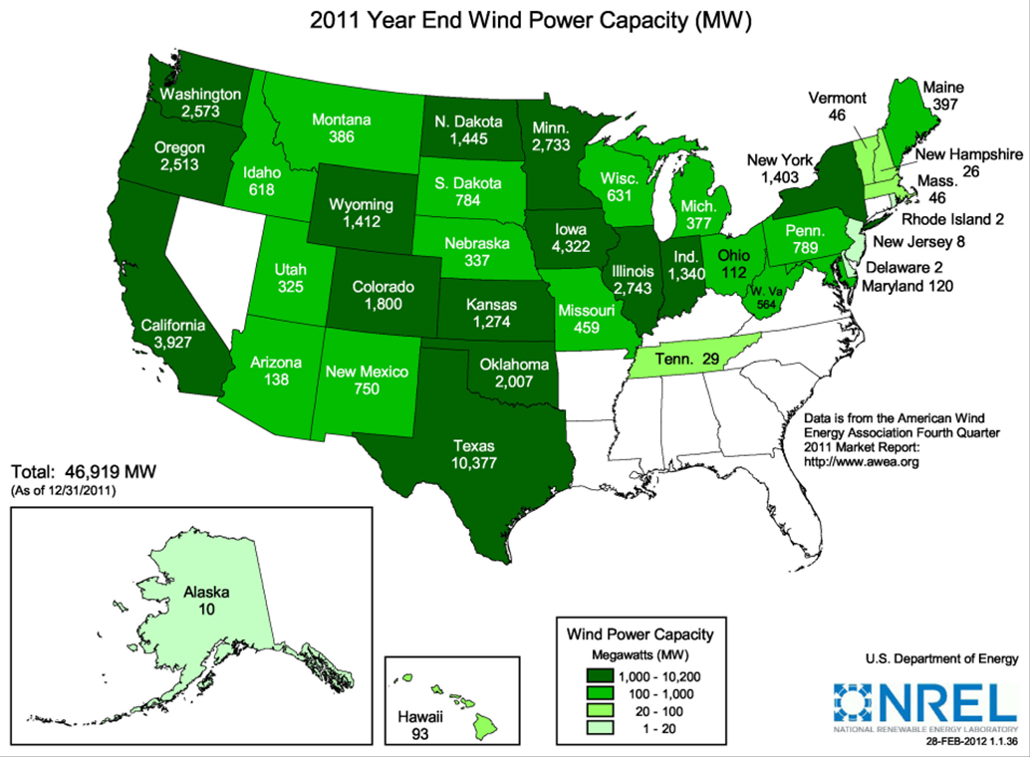
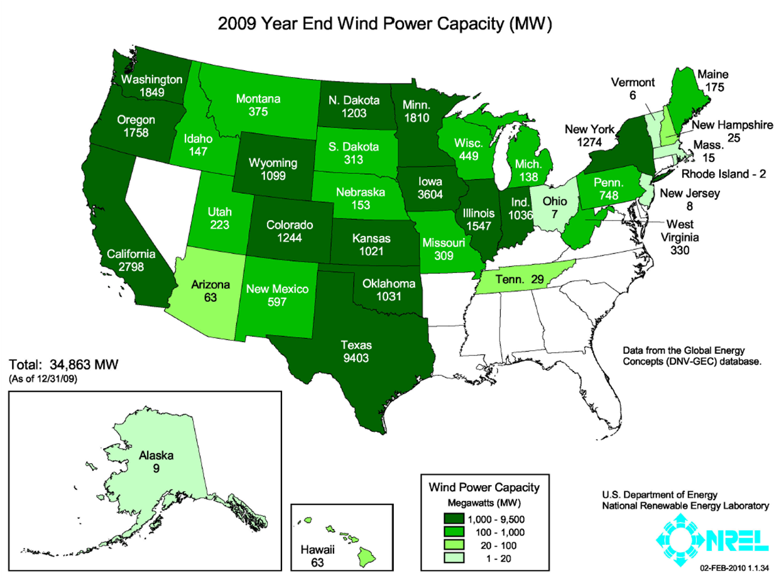
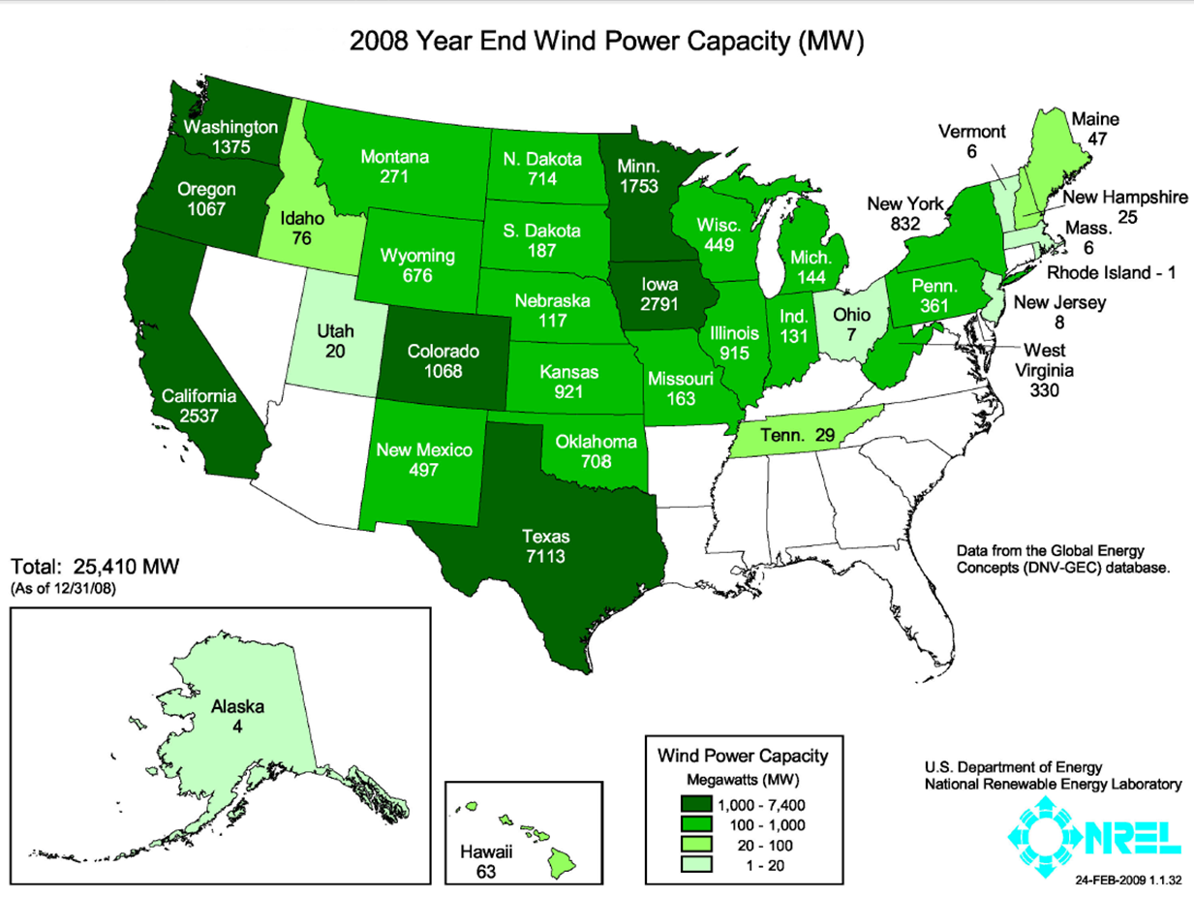
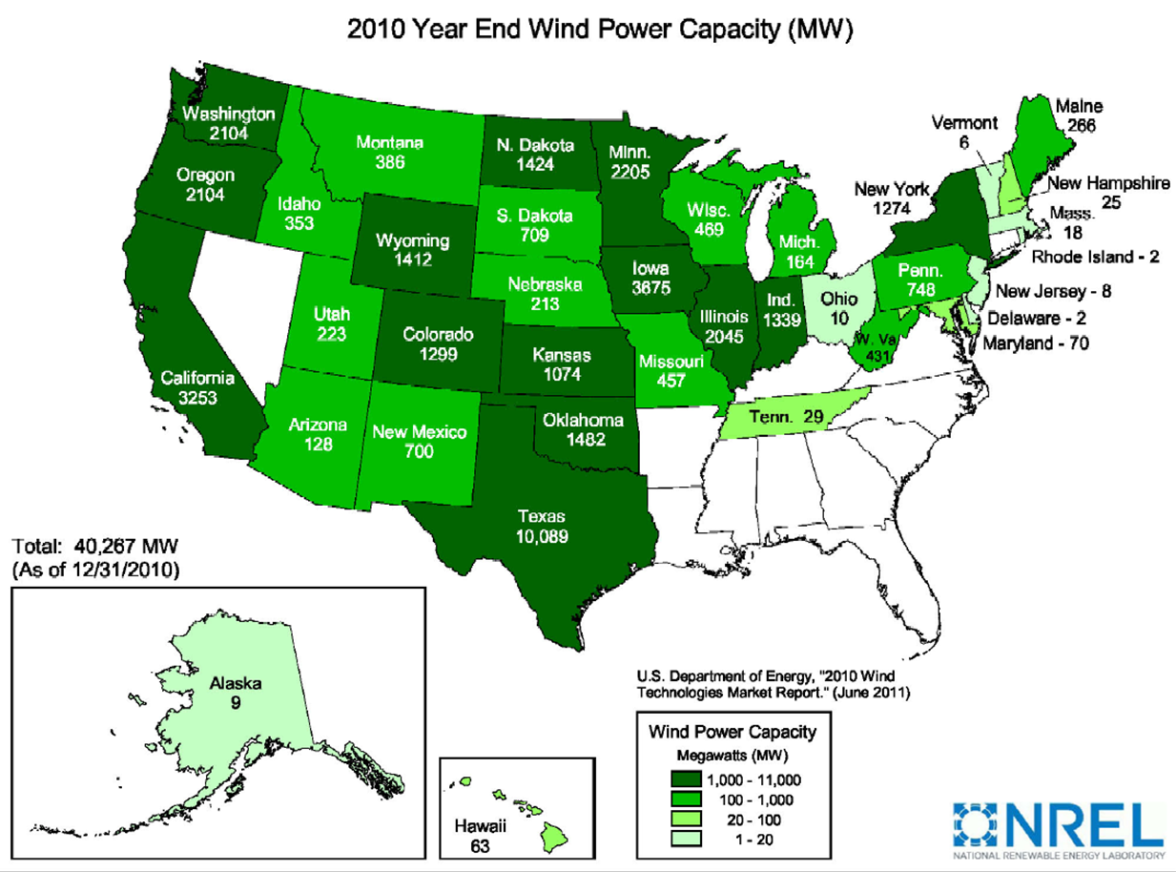
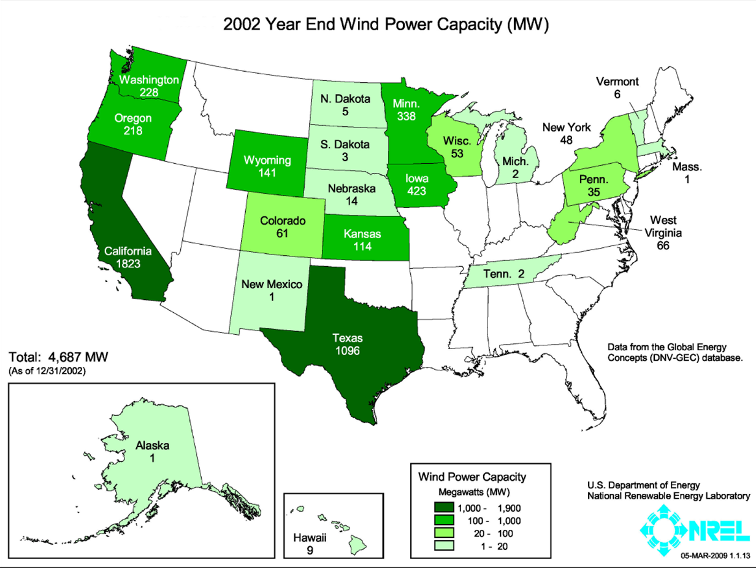
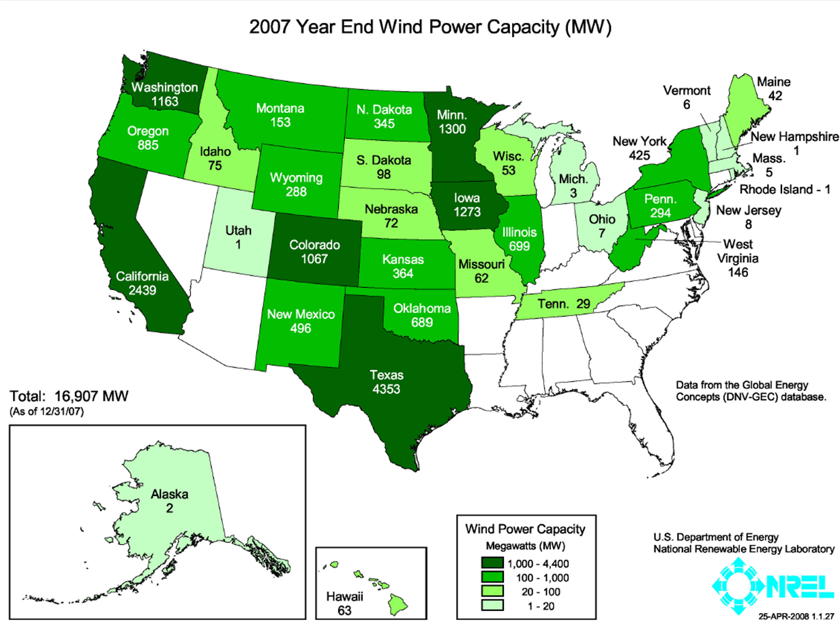
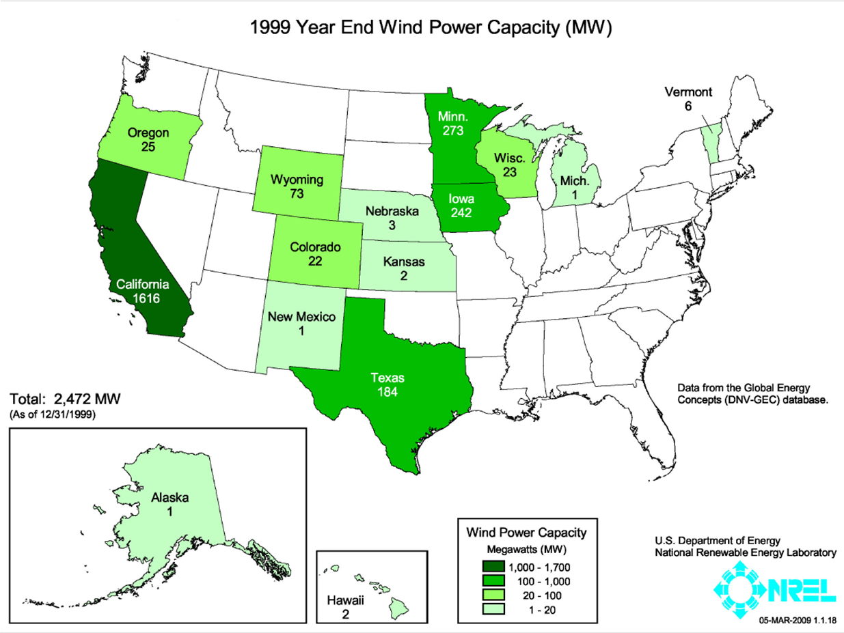
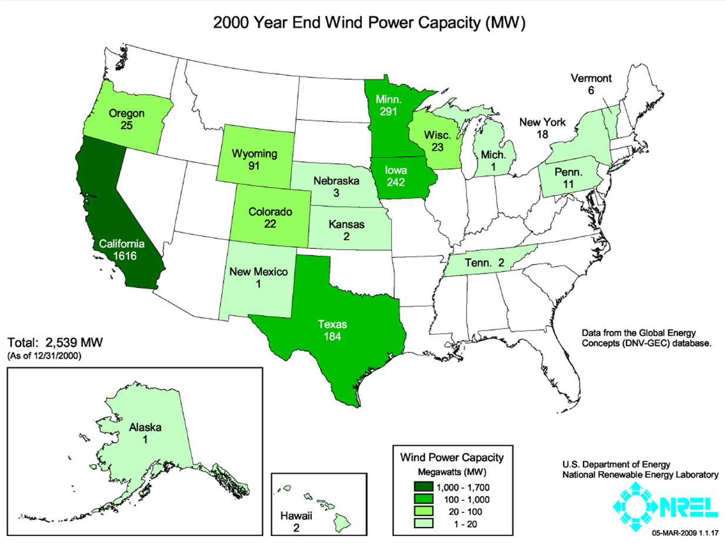
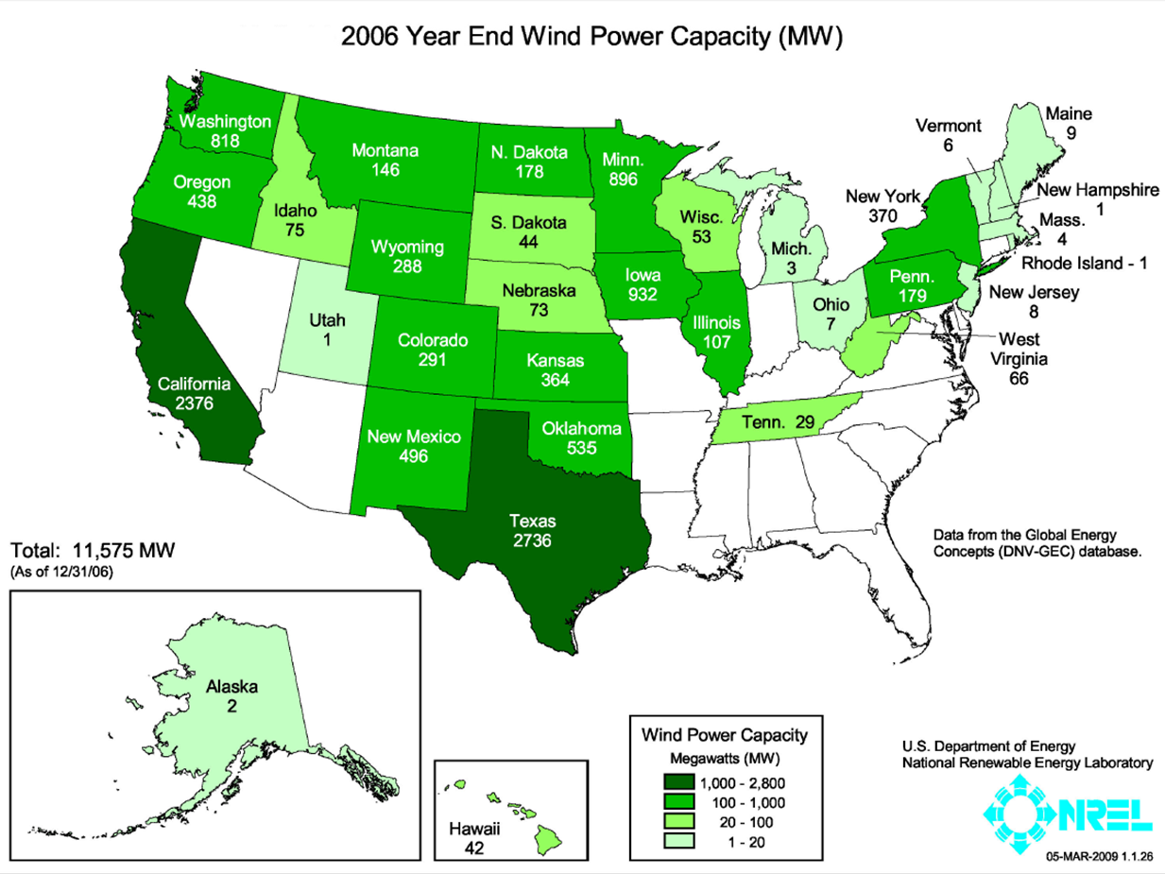
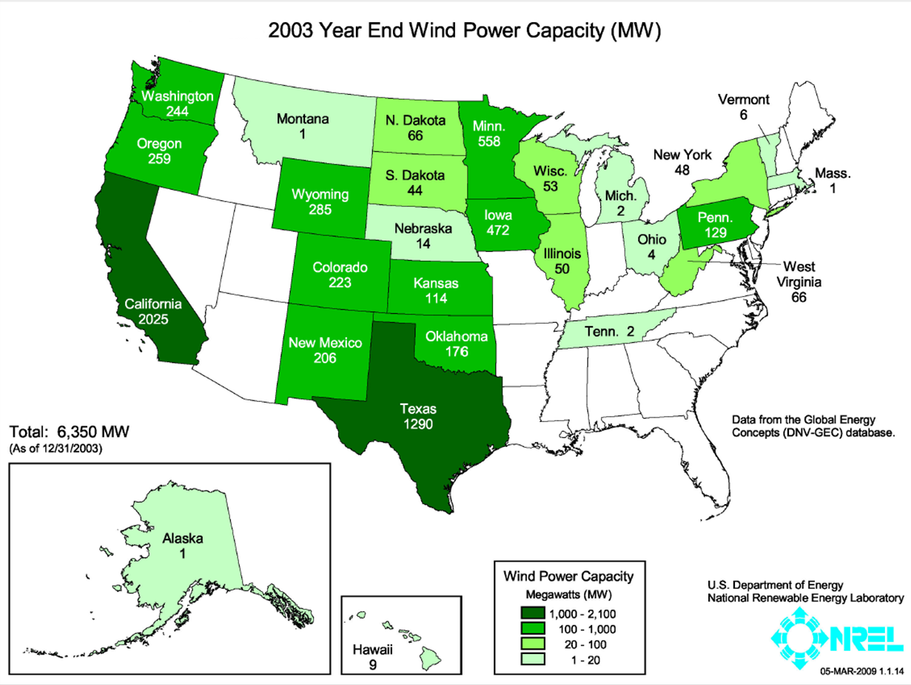


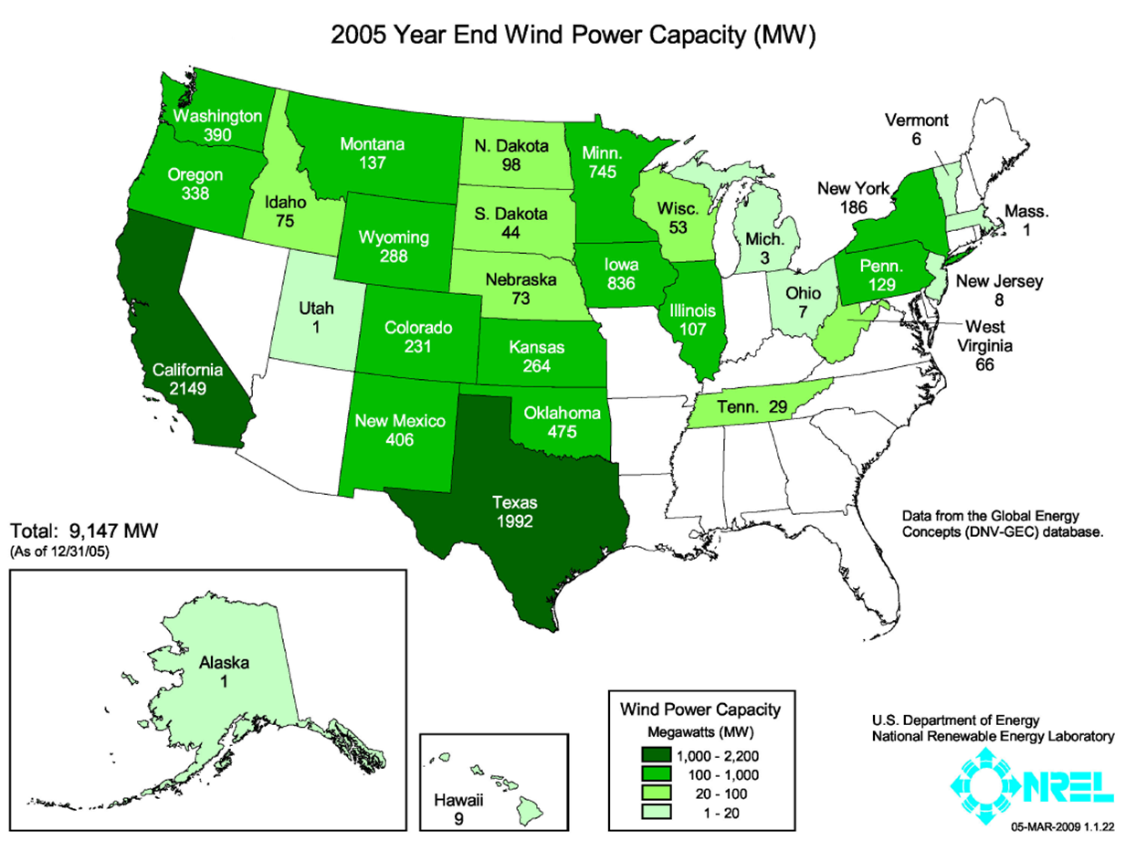
Installed Wind Power Capacity
NE ranked 24th in the U.S. for wind energy installed capacity with 459 megawatts (MW).
http://www.windpoweringamerica.gov/wind_installed_capacity.asp
Notes:
Installed wind power capacity has increased from just over 2000 megawatts (MW) in 1999 to over 60,000 MW in 2012.
Click through this slide to see how wind energy development has progressed in the U.S. – country goes from lots of white with only CA in dark green to lots of dark green.
Note the legend:
White= no development
Lightest Green = 1-20 MW
Light Lime Green = 20 – 100 MW
Lime Green = 100 – 1000 MW
Dark Green = 1000 – 1700 MW (1999); 1000 – 13,000 MW (2013)
The southeastern part of the U.S. still has no installed wind energy. The hubs of wind turbines are now reaching 100 m and can reach suitable wind speeds in areas such as SE U.S. So, development will, most likely, occur in those areas soon.

Slide 17
Project – Phase 1
What to look for:
  Good wind speeds (6.5 m/s or greater)
  Transmission lines
Break into groups
Use 100 m Wind Potential Map
Select 10 locations to build a wind farm.
Determine why you choose those locations.
In the “real” world, what other factors would you have to take into consideration.
Notes:
If you plan on using this activity more than once, you can laminate the maps so you can re-use them.
Encourage the students to look for places with good wind energy and transmission lines.
Students also often look for areas close to communities.

Slide 18
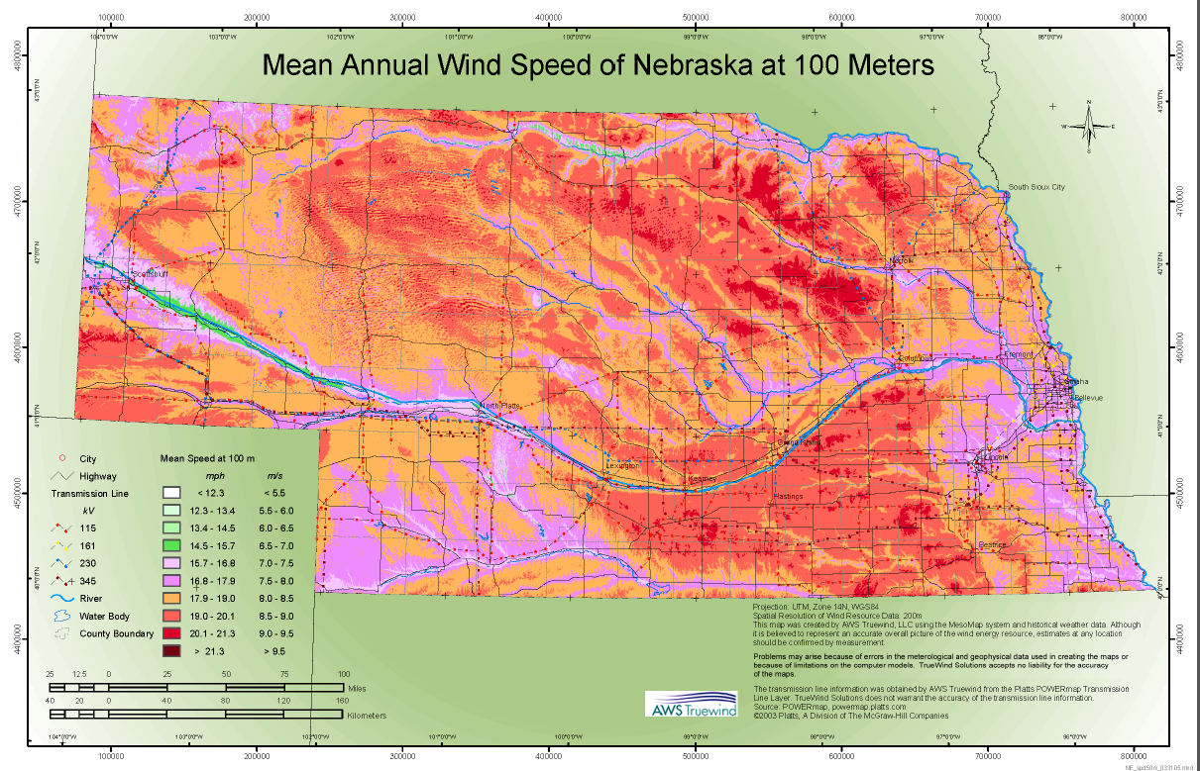
Notes:
This is the map to use because it has transmission lines and wind speeds. Note: 6.5 m/s is on the far right of the legend. Miles per hour are also listed which may confuse students.

Slide 19
Phase 1 Discussion
Locations selected for wind farms
Why? Based on the information provided, what factors did you into consideration?
Selecting a location with a good wind resource is important.
What other factors would you need to take into consideration in the “real world”?

Slide 20
Some other factors to consider…
Are there wildlife or habitat in the area that may be impacted by wind power development?
Notes:
There are many things the students could suggest:
Are there land owners willing to have wind turbines on their land?
Is there a utility that will buy the power (Do they have a power-purchase agreement)?
Do they have the permits they need?
Etc.
WILDLIFE – since that is the focus of this presentation…

Slide 21
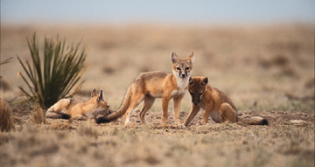
Nebraska’s Wildlife
Hundreds of species of wildlife live in Nebraska or migrate through, including over 400 species of birds
Number of species listed as threatened or endangered:
  Federal = 14
  State = 27
Swift fox – State Status Endangered - USFWS photo

Slide 22
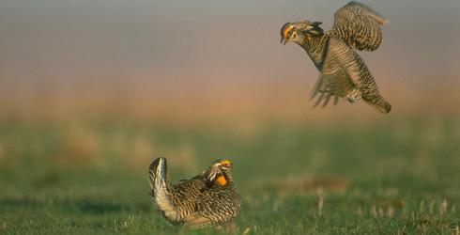
Laws Protecting Wildlife
Federal Endangered Species Act
State Endangered Species Act
Bald and Golden Eagle Protection Act
Migratory Bird Treaty Act of 1918
TNC image

Slide 23
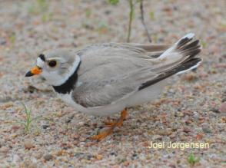
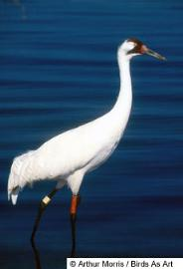
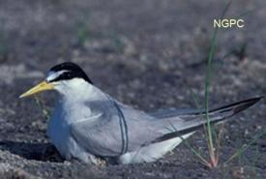
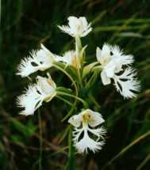
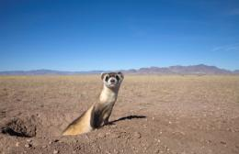
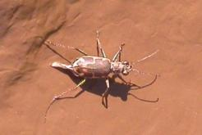
Federal Endangered Species Act
Threatened
Endangered
Interior Least Tern
Piping Plover
Whooping Crane
Western Prairie
Fringed Orchid
Salt Creek Tiger Beetle
Photo by: Seth Willey
Black-footed Ferret
Photo: R. List
Photo by: G. N. Rysgaard
Notes:
Federal Endangered Species Act
Passed by Congress and effective on December 28, 1973.
Established due to the extinction and/or depletion of fish, wildlife, and plant species in the United States as a consequence of economic growth and development untempered by adequate concern and conservation.
Prohibited Acts: possess, sell, deliver, carry, transport, or ship, buy any means whatsoever, any such species listed as threatened or endangered.
The penalty for the unlawful take of an endangered species is a fine of up to $100,000 and/or up to 1 year in jail.
“Take” = harass, harm, pursue, hunt, shoot, wound, kill, trap, capture, or collect, or to attempt to do any of these.

Slide 24

Whooping Cranes in Nebraska
The ONLY natural, self sustaining migratory flock
In the winter of 1941-1942, only 16 birds remained
Currently ~300 birds
Endangered
Species of concern for wind energy developers

Slide 25
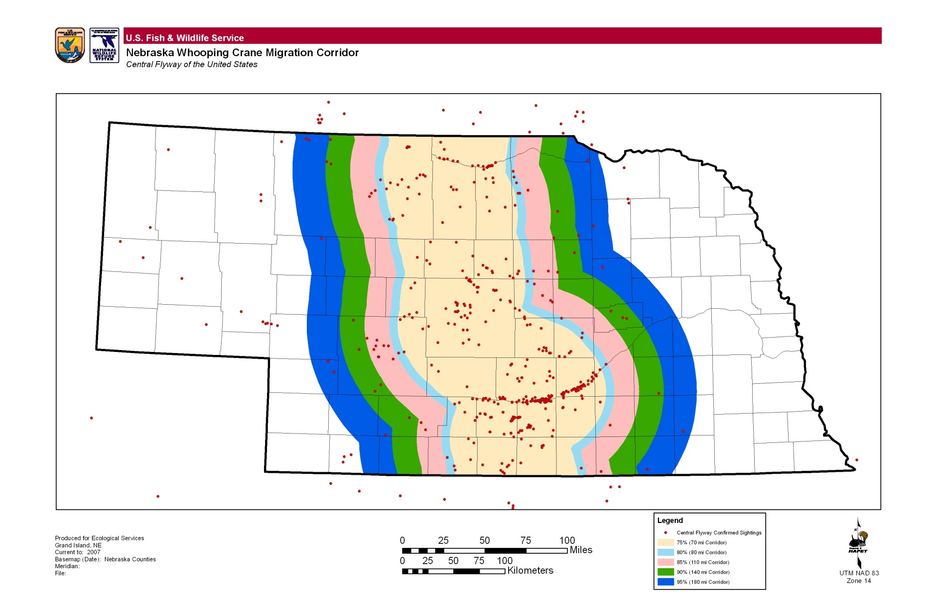
Map of Whooping Cranes in Nebraska
Notes:
This map shows the migratory corridor of whooping cranes.

Slide 26
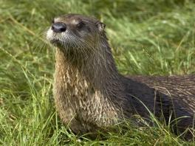
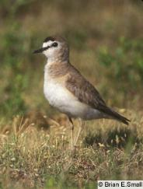
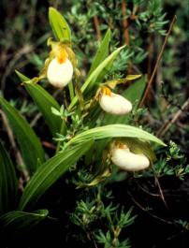

Nebraska Non-game and Endangered Species Conservation Act
Endangered
Threatened
River Otter
Photo: Nicole Duplaix
Small White Lady’s
Slipper
Photo by: Susan R. Crispin
Mountain Plover
Swift Fox Photo: USFWS
Notes:
Nebraska Non-game and Endangered Species Conservation Act
“The legislature hereby declares that nongame, threatened and endangered species have need of special protection and that it is in the public interest to preserve, protect, perpetuate and enhance such species of this state through preservation of a satisfactory environment and an ecological balance.” (Neb. Stat 37-804)

Slide 27
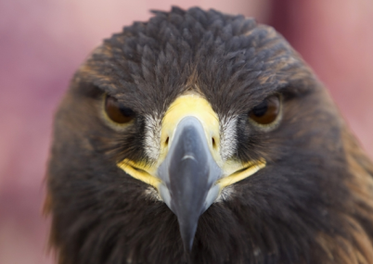
Bald and Golden Eagle Protection Act
Notes:
Enacted in 1940, prohibits anyone, without a permit issued by the Secretary of the Interior, from "taking" bald eagles, including their parts, nests, or eggs.
The Act defines "take" as "pursue, shoot, shoot at, poison, wound, kill, capture, trap, collect, molest or disturb.“
“Disturb" means: “to agitate or bother a bald or golden eagle to a degree that causes, or is likely to cause, based on the best scientific information available, 1) injury to an eagle, 2) a decrease in its productivity, by substantially interfering with normal breeding, feeding, or sheltering behavior, or 3) nest abandonment, by substantially interfering with normal breeding, feeding, or sheltering behavior."

Slide 28
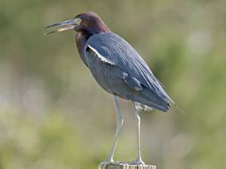
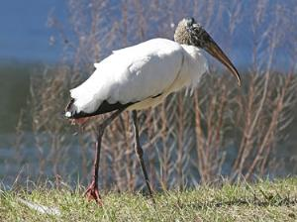
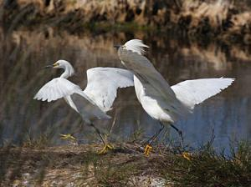
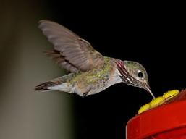
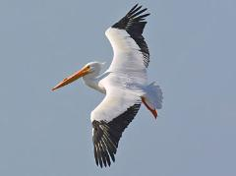
International Migratory Bird Treaty Act
Over 860 species of migratory birds in North America – only 58 have designated hunting seasons – ALL others are protected
Little Blue Heron
Wood Stork
Snowy Egret
Photos by: Phil Swanson
http://www.nebraskabirdlibrary.org/
American White Pelican
Calliope Hummingbird
Notes:
Migratory Bird Treaty Act of 1918
All migratory birds or any part, nest, or egg of any such bird are fully protected by law.
Prohibited actions (unless permitted by regulations) are: pursue, hunt, take, capture, kill; attempt to take, capture or kill; possess, offer for sale, sell, offer to purchase, purchase; deliver for shipment, ship, cause to be shipped, deliver for transportation, transport, cause to be transported; carry, or cause to be carried by any means whatever, receive for shipment, transportation or carriage, or export
Treaties or Conventions are between the United States and Canada, Japan, Mexico, and Russia.

Slide 29
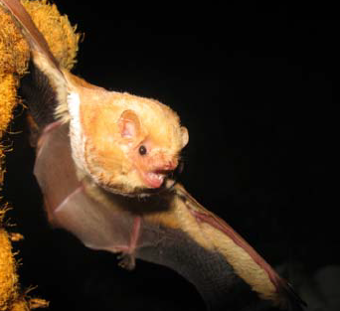
Bats of Nebraska
13 kinds of bats
Most require rocks or crevices for protection
Forested areas along rivers and in cities (buildings)
Resident and migratory species
Consume night-flying insects
Eastern red bat . Geluso.

Slide 30
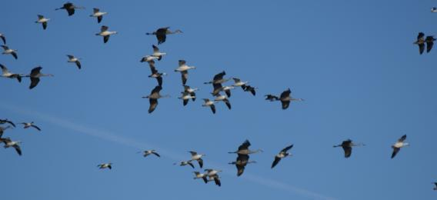
Potential Impacts of Wind Energy Development on Wildlife
Image by Fontaine.
Wind energy development can have negative impacts on wildlife.

Slide 31
Potential Impacts to Wildlife
Birds and bats can have fatal collisions with wind turbines and/or associated transmission lines.
Wind farm construction and infrastructure, including roads and transmission lines, can:
  fragment habitats,
  create barriers to migration,
  introduce invasive species,
  disturb animal behavior and/or displace wildlife from an area.

Slide 32
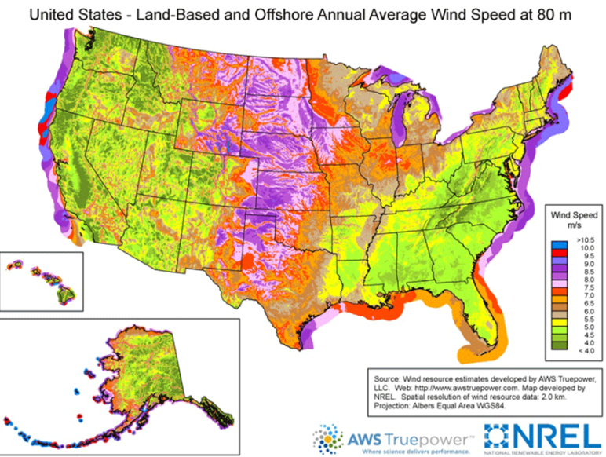
Wind Energy Potential @ 80m
http://www.nrel.gov/gis/images/80m_wind/awstwspd80onoffbigC3-3dpi600.jpg
Notes:
Here is a map of the wind energy potential both on-shore and off-shore. Note where the purple, red, and blue areas are. These are areas of really good wind energy potential.

Slide 33
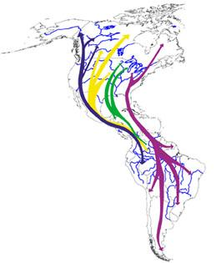
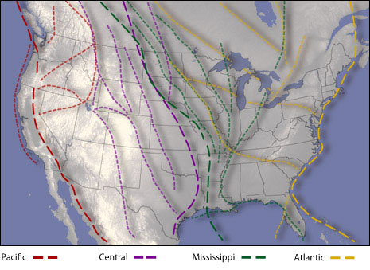
Bird Migration Flyways
Image: Hunter Allen (http://www.climatewatch.noaa.gov/article/2010/watching-birds)
http://10000birds.com/flyways-and-byways.htm
Notes:
Several of the areas where there was really good wind energy potential are also areas that birds use to migrate north and south every year. The birds are using that great wind to assist with their migrations.

Slide 34
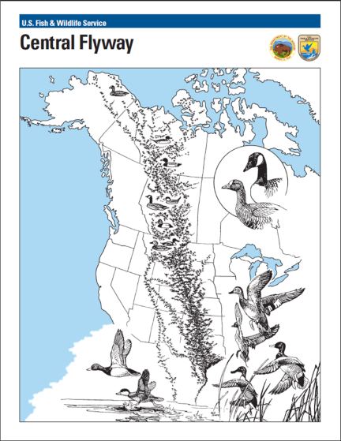
Migratory birds in Nebraska
The Rainwater Basin in south central Nebraska, is the narrowest portion of the Central Flyway.
3- 6 m snow geese, 4 m mallards, ~1 m white-fronted geese, ~1 m pintails, and many more, including cranes, fly through in the spring.

Slide 35
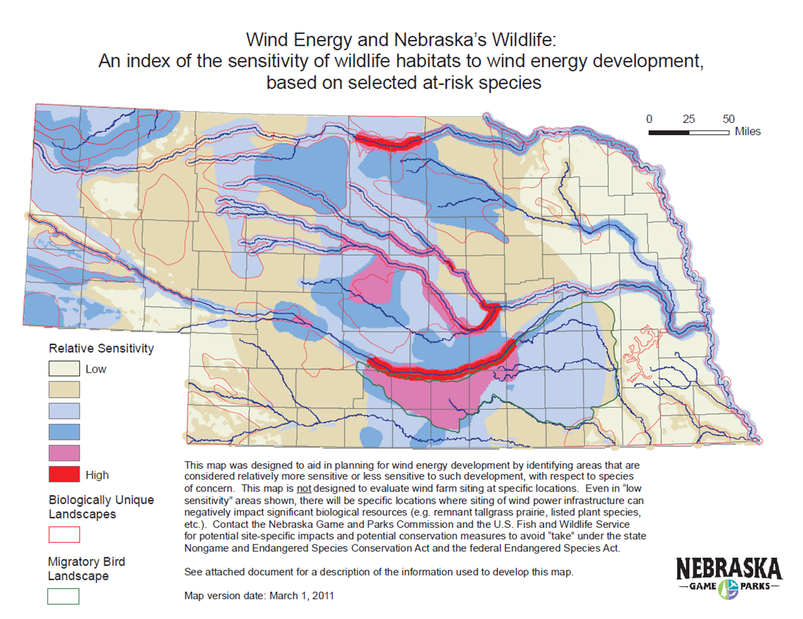
Wind Energy & Nebraska’s Wildlife Map
Notes:
The Wind Energy and Nebraska’s Wildlife map was developed by looking at the habitats of 13 species that could be impacted by wind energy development. Three bat species and nine bird species were considered.
The legend of the map shows the Relative Sensitivity of areas to wind energy development.
The areas with the lightest colors have the lowest relative sensitivity, whereas the bright pink and red have the highest sensitivity.
The bright pink and red area in the south-central part of the state are the Rainwater Basins and the Platte River – areas where Sandhill and Whooping Cranes and millions of waterfowl and shorebirds rest and feed each year.
This map gives someone a good idea of areas of the state where wind energy development may have a greater impact on wildlife and their habitats.

Slide 36
Project – Phase 2
You were just given the Wind Energy and Nebraska’s Wildlife map, re-evaluate the wind farm sites you had identified in Phase 1.
Phase 2:
  Break into the same groups.
  Use the Wind Energy and Nebraska’s Wildlife map and the 100 m Wind Potential Map.
  Determine the relative sensitivity of wildlife to wind energy development for each of your previously selected sites.
  Select the best 5 sites.

Slide 37
Phase 2 Discussion
Which sites did you eliminate from consideration?
Why?
Notes:
Some students may decide to keep sites in areas with higher sensitivity because of wind speeds, access to transmission lines, or another reason. A decision like that could and does occur in real life.

Slide 38
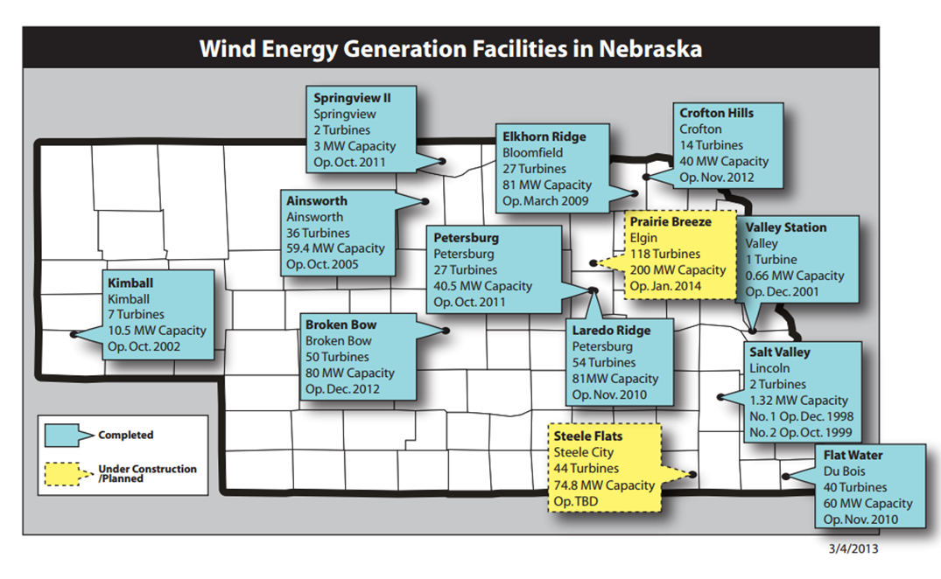
Nebraska Wind Farms
How did your locations match up with the locations of wind farms in Nebraska?
http://www.neo.ne.gov/statshtml/89_map.pdf

Slide 39
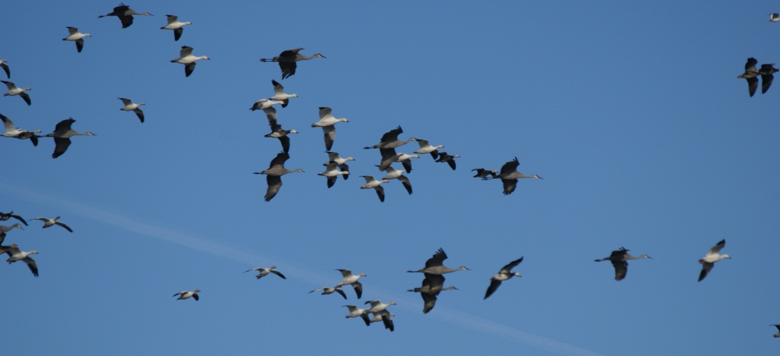
Potential Impacts of Wind Energy Development on Wildlife
Wind energy development can have impacts on wildlife.
How can we minimize these impacts?

Slide 40
Mitigation
Avoid, Minimize, Mitigate
It is best to AVOID impacts, if possible.
Next, MINIMIZE impacts as much as possible.
Lastly, MITIGATE impacts = $$

Slide 41
Steps to Minimize Impacts
Consult with the Nebraska Game and Parks Commission (NGPC) and the U.S. Fish and Wildlife Service (USFWS) and other agencies in the area.
NGPC and USFWS are the regulatory authorities that know the laws protecting wildlife in the state and can provide siting and operational recommendations.

Slide 42
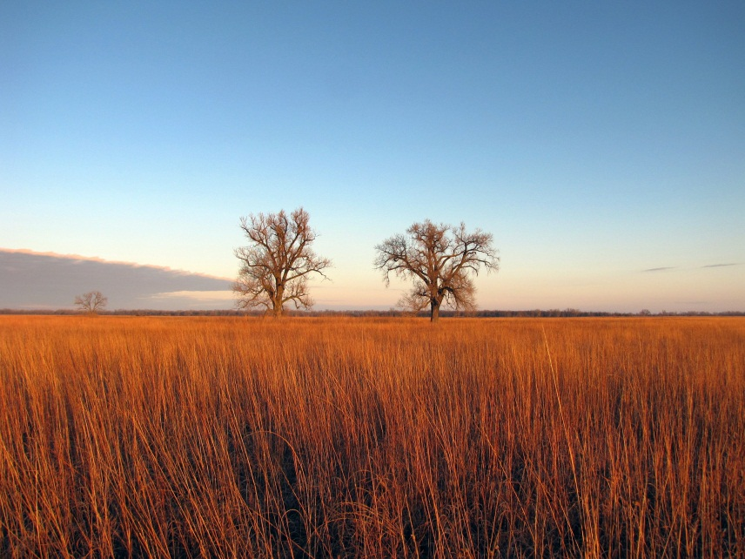
Ways to Minimize Direct Impacts- 1
SITING – where the wind farm is located
Take into consideration wildlife presence in the area – local and migratory
Habitat type – agricultural, prairie, river, etc.
Proximity to: water, forest edge, ridge top, caves, etc.
Photo by: Joseph Fontaine.

Slide 43

Wind Energy & Nebraska’s Wildlife Map
Use this map to help with siting.

Slide 44
Ways to Minimize Direct Impacts- 2
CHANGE OPERATIONS
Bats:
  In many places, the slower the wind speed, the more bat deaths
  Feather turbine blades so they do not turn unless the wind turbine is producing energy
  Increase the wind speed that the wind turbine uses to start producing energy
Birds and Bats:
  Do not have wind turbines on during peak migration if deaths are occuring

Slide 45

Ways to Minimize Direct Impacts- 3
ENGINEERED SOLUTIONS
Use a single pole tower design instead of lattice which may attract birds to perch
Do not use guy wires
Only use lighting when required
Bury transmission lines
Notes:
All of these have been shown to help reduce fatalities at wind energy facilities.

Slide 46
Ways to Minimize Direct Impacts- Bats
OTHER SOLUTIONS
Color of turbines – one study found that purple turbines attracted fewer insects and therefore bats
Deterrents –a device that broadcasts ultrasonic noise placed on turbine could cause bats to avoid the area

Slide 47
Summary Minimizing Impacts
Wind energy developments have the potential to have direct and indirect impacts on wildlife and the environment.
Studies can and have helped provide ways to minimize potential impacts.
By being aware of the potential impacts and working with the natural resource agencies, the siting and operation of wind farms can be in a manner that minimizes impacts.

Slide 48

Questions?
Photo by: TJ Fontaine
Notes:
If you would like to have me available for questions on the day you do this activity in your class, please coordinate with me beforehand. I can be reached at windwildlife@unl.edu.

